Slide 1
Study And Implementation Of Logistic Regression
32513 31005 Advanced Data Analytics Algorithms, Machine Learning - Spring 2025

Slide 2

Task Definition & Project Setup
What is Logistic Regression? Logistic Regression is a supervised machine learning algorithm used for binary classification tasks.It estimates the probability that an input belongs to a certain class by applying a sigmoid (S-shaped) function to a linear combination of input features. It outputs a value between 0 and 1, representing how likely the input belongs to the positive class
Task/Objective
The goal is to predict whether an input belongs to the positive (1) or negative (0) class, for example: detecting if a tumour is malignant or benign by estimating the probability using the logistic function.
HYPOTHESIS FUNCTION | DEFINITIONS
 | x: input features w: model weights b: bias term σ(z): sigmoid function converting scores to probabilities Predict class 1 if y^hat > 0.5, else class 0

Slide 3
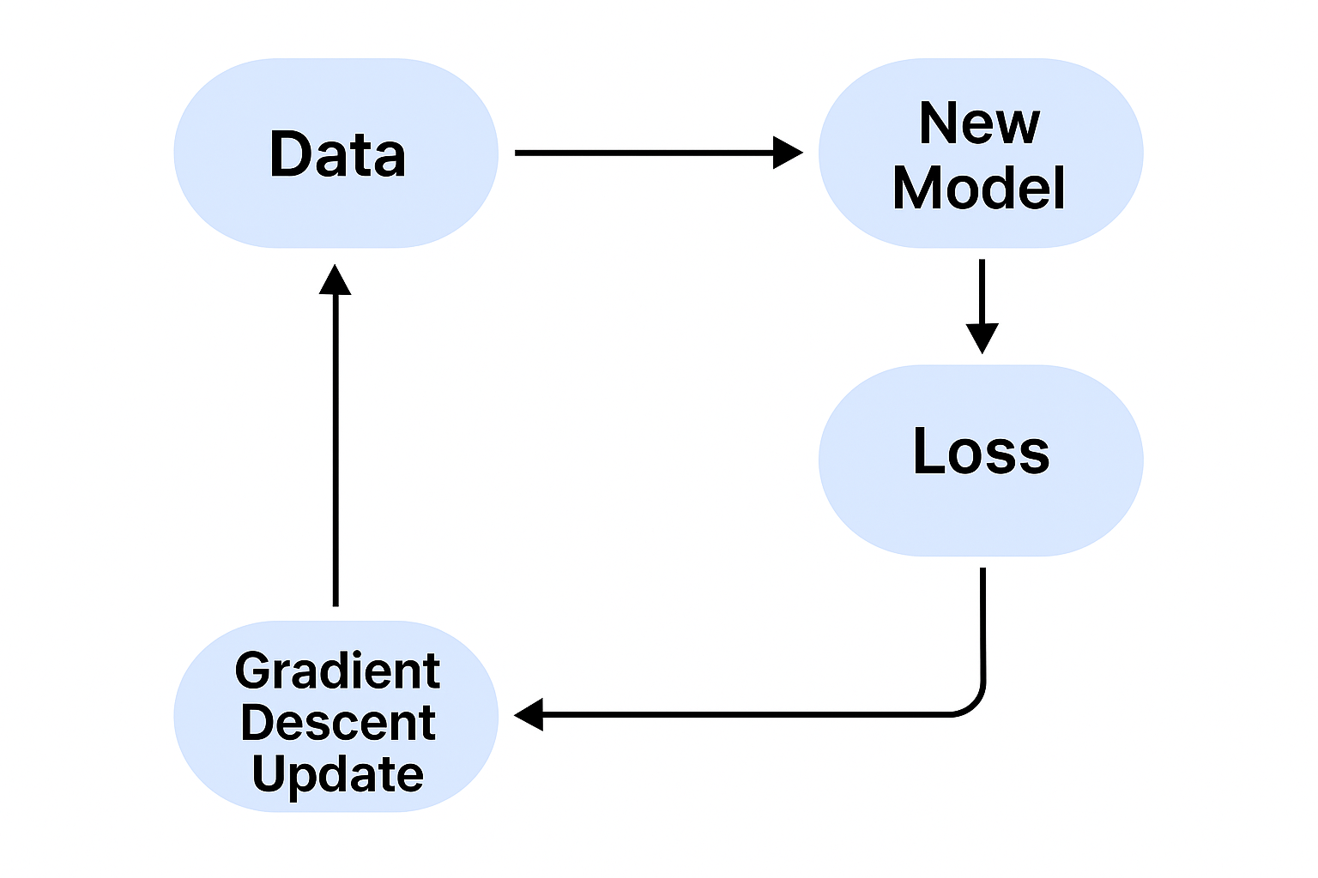
How The Model Learns
OPTIMIZER — Gradient Descent:
L = -(1/n) * Σ [ y * log(ŷ) + (1 - y) * log(1 - ŷ) ]
Penalises confident wrong predictions.
Provides smooth gradients for optimisation.
Ideal for binary classification.
OPTIMIZER — Gradient Descent:
w = w - η * (∂L/∂w)
b = b - η * (∂L/∂b)
η = learning rate (controls step size).
Updates move weights toward lower loss.
Repeats for many epochs until convergence.
The model learns by comparing its predictions with the true labels and adjusting its parameters to reduce error.It uses the Binary Cross-Entropy Loss (BCE) to measure how far off predictions are, and Gradient Descent to iteratively update the weights and bias.Over many epochs, the loss decreases as the model’s predictions become more accurate.

Slide 4
Problems And Limitations
MAIN LIMITATIONS:
Linearity assumption: struggles with non-linear relationships between features and output.
Feature scaling: model performance depends heavily on normalised input values.
Outliers: extreme values can shift the decision boundary significantly.
Class imbalance: if one class dominates, accuracy can be misleading.
Interpretability trade-off: coefficients are easy to interpret, but probability outputs may not reflect uncertainty perfectly.
Logistic Regression works well for simple, linearly separable problems, but it has several limitations.
It assumes a linear relationship between the input features and the log-odds of the output, which restricts its ability to model complex or non-linear patterns.
The model is also sensitive to feature scaling and class imbalance, which can distort probability estimates.

Slide 5
Possible Improvements
Use a Feedforward Neural Network (MLP) to learn non-linear relationships that Logistic Regression cannot capture.
Apply Gradient Boosting methods (e.g., XGBoost or LightGBM) to combine weak learners into a stronger, more accurate ensemble.
Introduce regularisation (L1/L2) to reduce overfitting and improve model generalisation.
Evaluate using recall, F1-score, or ROC-AUC instead of accuracy to handle class imbalance more effectively.
Continue exploring multiclass Softmax Regression as a theoretical extension of the binary case.

Slide 6
Key Insights & Reflection
Key Insights
The project demonstrated how the hypothesis, loss, and optimizer interact to form a complete learning loop.
The Binary Cross-Entropy loss provided continuous feedback, while accuracy alone offered only a limited evaluation measure.
The behaviour of gradient descent illustrated how iterative updates convert model error into learning.
Observations confirmed that linearity restricts Logistic Regression, motivating more flexible models such as neural networks.
Overall, the implementation highlighted that most modern ML techniques still follow the same foundation: prediction → loss → optimization.
Reflection
Developing the model from first principles clarified how mathematical formulations translate directly into computational routines.
The process emphasised the value of interpretable models for understanding learning behaviour.
Analysis of evaluation metrics underscored that performance interpretation depends on dataset balance and task goals.
The study demonstrated that even fundamental algorithms can serve as an effective framework for understanding more advanced methods.

